Slide 1

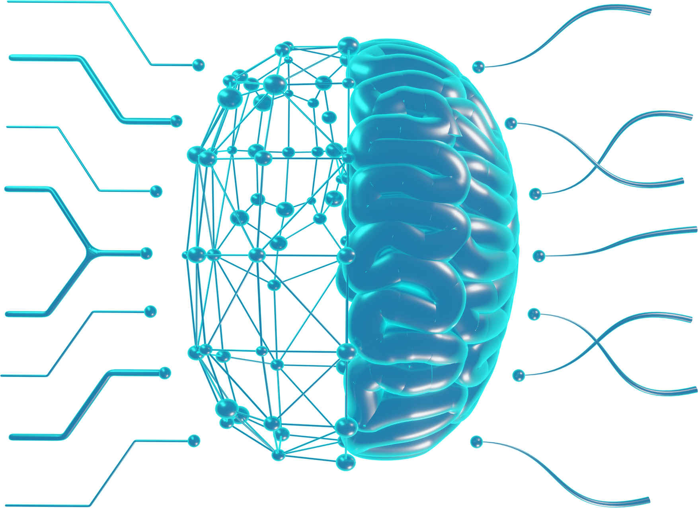
Next-Generation Language Model for On-Device Natural Language Processing

Slide 2













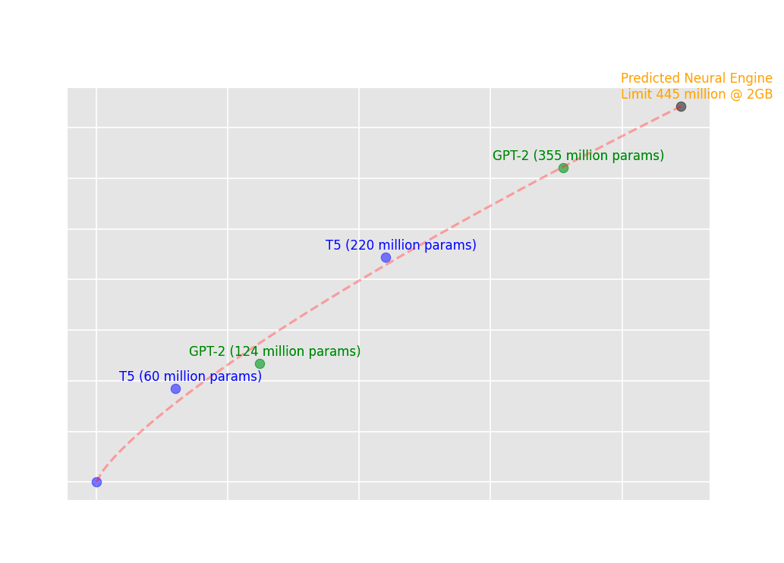
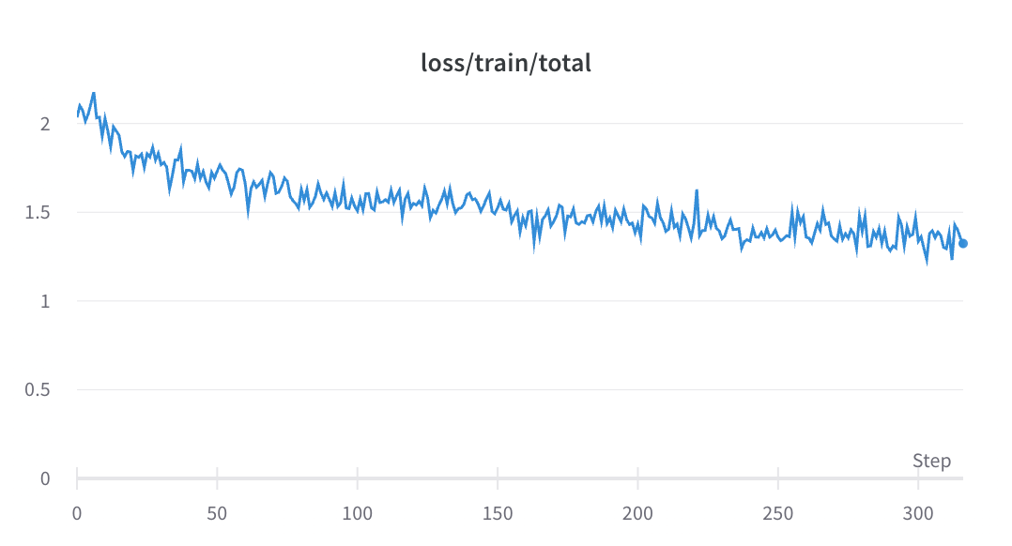


Next-Generation Language Model for On-Device Natural Language Processing
Aditya Kendre, Hien Nguyen, Suman Saha
Computer Science
Penn State Harrisburg
The Iceberg
The Problem
What are LLMs
Pretraining
KEY CONTRIBUTION 1
Distilling Knowledge
Finetuning
KEY CONTRIBUTION 2
Deployability
Reinforcement
Learning
+
+
Efficiency & Deployability
Boosted
Explanation Tuning
Distilling Knowledge
Deployability
Results
How do they work?
Next Token Prediction
Future Works
have
Large Language Models (LLMs)
are
make
in
Boosted
Explanation Tuning
Embeddings &
Vector Databases
Local Deployment
Notes:
What led you to be interested in this topic?
How do you see yourself as a researcher in your discipline after completing this project?
What makes this for on-device over other models?

Slide 3
What are LLMs
have
are
Large Language Models (LLMs)
make
in
How do they work?
Next Token Prediction
Notes:
Large Language Models (LLMs) have made significant breakthroughs in natural language processing (NLP) tasks, such as language translation and text generation. These models, powered by advanced deep learning techniques, have revolutionized the field of NLP and opened up new possibilities for understanding and generating human-like text. By leveraging massive amounts of data and complex algorithms, LLMs have achieved unprecedented levels of performance in various language-related tasks, captivating researchers and industry professionals alike.

Slide 4
LLM Pipeline
Pretraining
Train model on trillions of words, often extracted from the internet - learn basics of language.
Finetuning
Tune model on high quality texts that resemble ideal model output, e.g. conversations
Reinforcement Learning
Using human assistance, the model receives feedback in the form of rewards or penalties.
Notes:
The intuition behind training LLMs lies in the vast amount of data used to develop their understanding of language. Being trained on massive datasets that include a wide variety of texts, ranging from books and articles to websites and social media. Through this exposure, the model learns to recognize patterns, grammar rules, word associations, and contextual meanings present in human language. By tailoring the data to a particular domain or task, the model can learn context-specific information, patterns, and nuances that are crucial for excelling at that specific task.

Slide 5
Finetuning
The Problem
Tune model on high quality texts that resemble ideal model output, e.g. conversations
KEY CONTRIBUTION 1
Distilling Knowledge
KEY CONTRIBUTION 2
Deployability
Notes:
The computational and hardware requirements associated with LLMs often require specialized hardware even for prediction, let alone training. Therefore the need for good quality models that perform well in constrained resource environments is paramount. Addressing this problem is crucial to making LLMs more widely available and practical for various applications, from mobile devices to edge computing and offline use-cases.

Slide 6
Our Goal
+
+
Boosted
Explanation Tuning
Distilling Knowledge
Deployability
Utilize explanatory datasets that captures detailed explanations of possible solution paths for various language tasks.
Train a smaller model (student) to imitate the behavior and knowledge of a larger, more complex model (teacher) to achieve similar performance levels.
Effectively and efficiently implemented LLMs on various devices or platforms, allowing users to access its language processing capabilities in a practical and accessible manner.

Slide 7
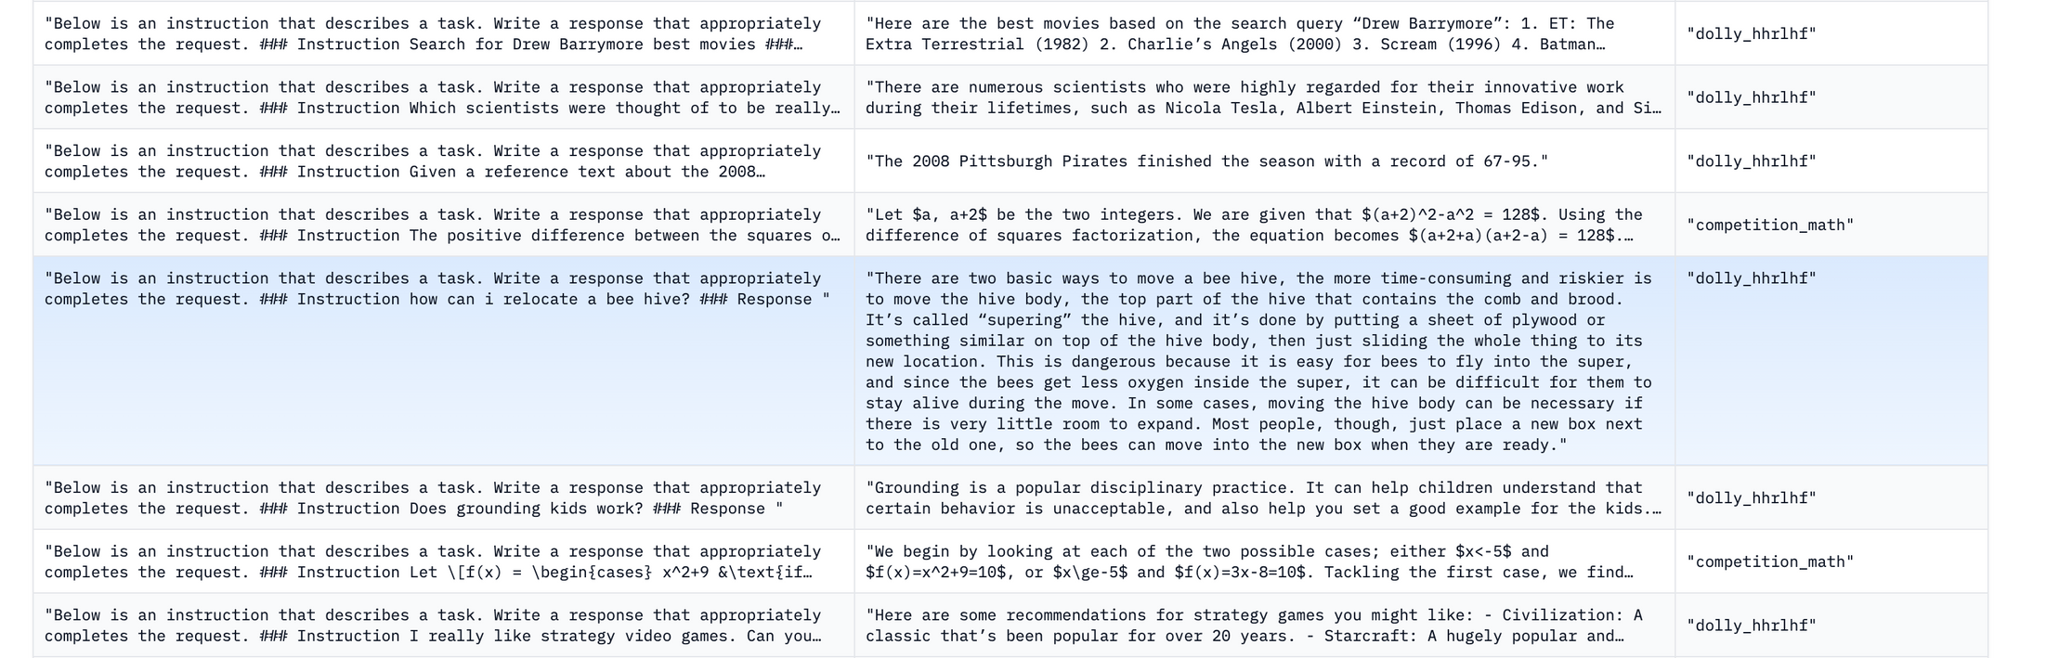
Distilling Knowledge
mosaicml/instruct-v3

Slide 8
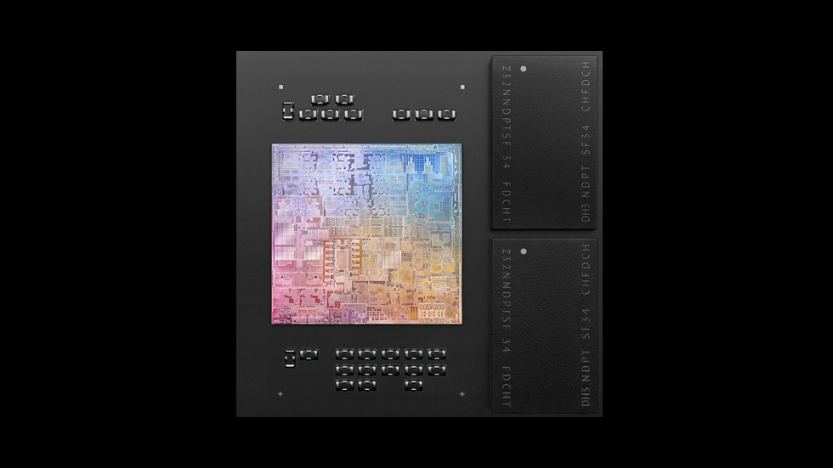
Efficiency & Deployability
Apple's Neural Engine allows for fast and efficient inferences over various platforms like iOS and MacOS.

Slide 9
Results
1
It's Learning!
2
Room for improvement!

Slide 10
Future Works
Boosted
Explanation Tuning
Embeddings &
Vector Databases
Local Deployment

Slide 11



Our team
HIEN NGUYEN
SUMAN SAHA
ADITYA KENDRE
Advisor
Advisor
Researcher
Computer Science, Engineering, and Technology
Computer Science and Engineering
CS Student

Slide 12
Questoins
What led you to be interested in this topic?
How do you see yourself as a researcher in your discipline after completing this project?
What makes this for on-device over other models?

